Slide 1


REVIEW - 1
ANOMALY DETECTION IN MEDICAL IMAGES USING TRANSFORMERS-BASED GANS
Presented By Nayan Khemka (20BCE1884) Guide: Professor Premalatha M.

Slide 2
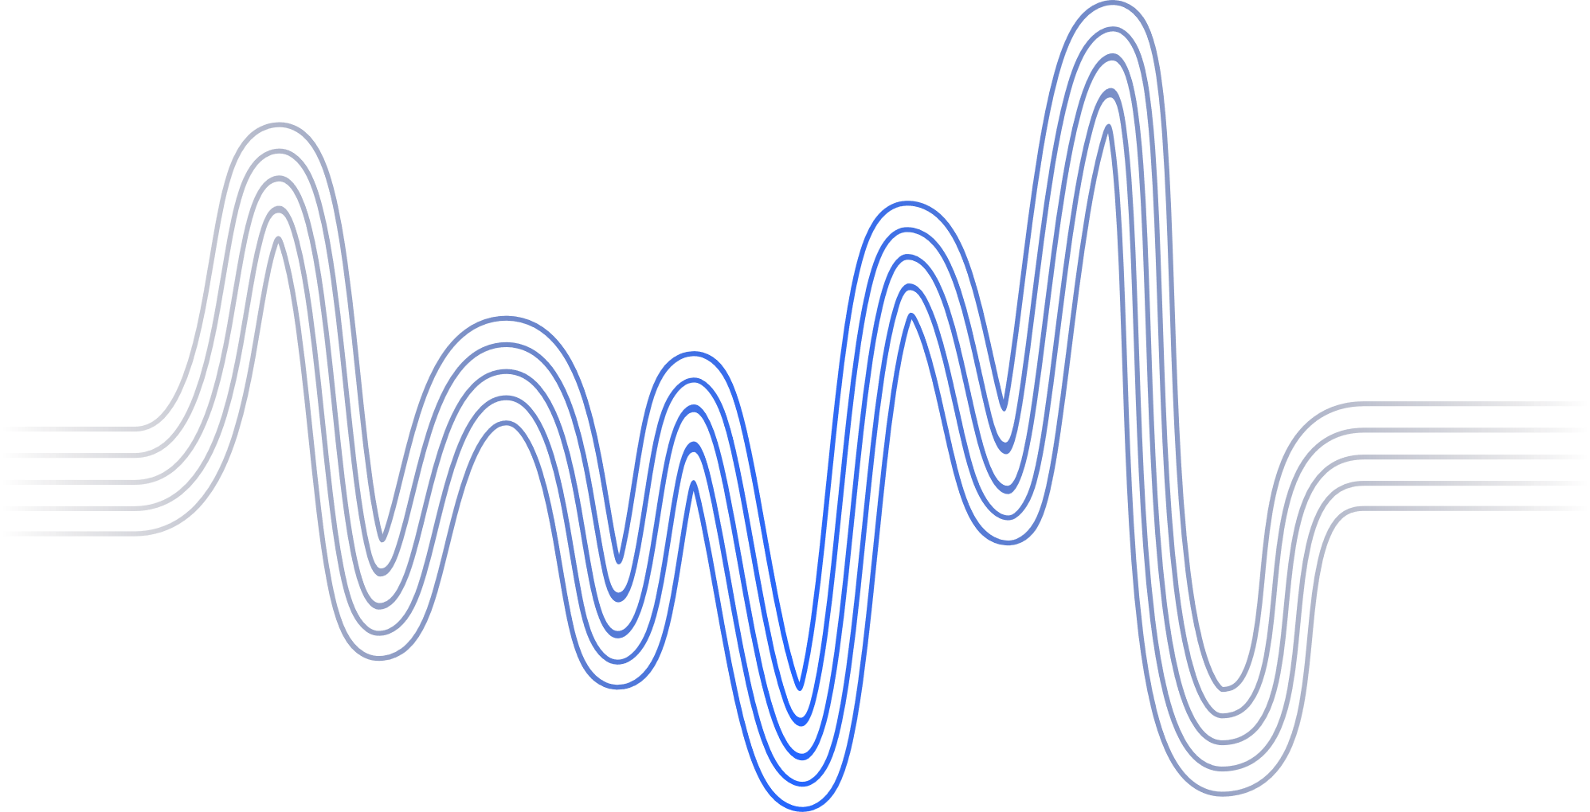
Introduction
Literature Review
Problem Statement
Research Challenges
Research Objectives
Methodology
Proposed System
Next Step
Research Paper Status
Guide Approval
Timeline
References
AGENDA

Slide 3
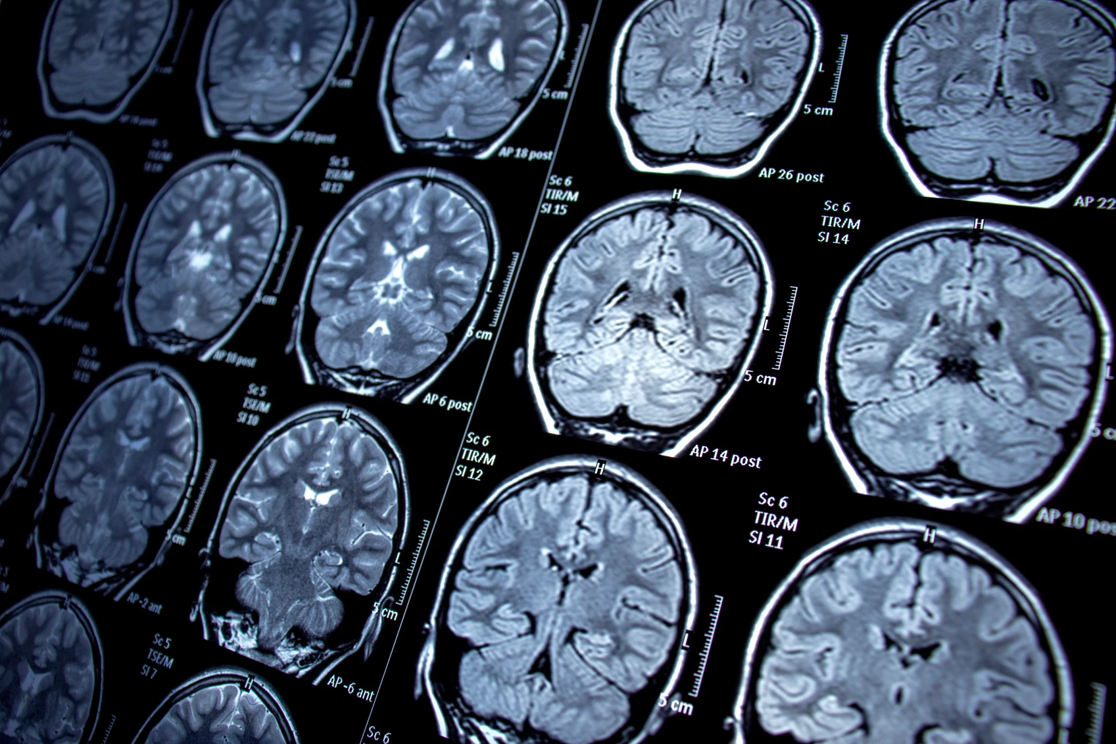

INTRODUCTION
This research proposes a novel approach to anomaly detection in medical images using a combination of transformer-guided Generative Adversarial Networks (GANs) and attention-based highlighting.
Back to Agenda
Notes:
We introduce a unique GAN architecture where transformers guide the generation of subtle and diverse anomalies, specifically relevant to the medical domain. Additionally, we employ an attention-based post-processing technique to highlight the generated anomalies, aiding the detection model's focus and interpretability. This approach aims to outperform existing methods by generating more realistic and diverse anomalies, boosting the detection model's performance, and providing interpretable insights into the identified anomalies.

Slide 4
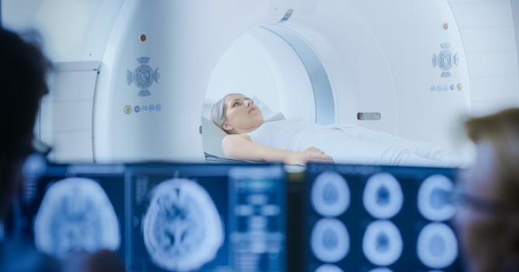

INTRODUCTION
Early detection of anomalies in medical images is crucial for timely diagnosis and effective treatment. This research addresses limitations in existing anomaly detection methods by: Leveraging transformer-guided GANs: Utilizing transformer networks to guide GANs in generating realistic and diverse anomalies specific to medical imaging. Employing attention-based highlighting: Introducing an attention mechanism to highlight generated anomalies, enhancing the detection model's interpretability.
Back to Agenda

Slide 5
Back to Agenda
LITERATURE SURVEY
[1] Chalapathy, R., & Chawla, S. (2019). Deep learning for anomaly detection: A survey. arXiv preprint arXiv:1901.03407.
The paper provides a thorough survey of deep learning-based anomaly detection methods, categorizing them and assessing their effectiveness across domains such as health and cyber-security.
It emphasizes the lack of comparative analyses for deep learning architectures in outlier detection and highlights the promising results of deep learning techniques in various applications like fraud detection and medical domains.
The paper suggests the need for further research to address challenges in real-world applications
Notes:
[1] Michael, Baumgartner., Saikat, Sinha, Roy., Tassilo, Wald., Klaus, H., Maier-Hein. (2023). Taming Detection Transformers for Medical Object Detection. arXiv.org, abs/2306.15472:183-188. doi: 10.1007/978-3-658-41657-7_39
[2] (2023). Industrial and Medical Anomaly Detection Through Cycle-Consistent
Adversarial Networks. doi: 10.48550/arxiv.2302.05154
[3] (2023). Industrial and Medical Anomaly Detection Through Cycle-Consistent
Adversarial Networks. doi: 10.48550/arxiv.2302.05154
[4] (2023). Generative Adversarial Networks for Anomaly Detection in Biomedical Imaging: A Study on Seven Medical Image Datasets. IEEE Access, 11:17906-17921. doi: 10.1109/access.2023.3244741
[5] (2023). MultiNet with Transformers: A Model for Cancer Diagnosis Using Images. doi: 10.48550/arxiv.2301.09007

Slide 6
Back to Agenda
LITERATURE SURVEY
[2] Bougaham, A., Delchevalerie, V., Adoui, M. E., & Frénay, B. (2023). Industrial and Medical Anomaly Detection Through Cycle-Consistent Adversarial Networks. arXiv preprint arXiv:2302.05154.
The paper proposes an unsupervised anomaly detection method using Cycle-Generative Adversarial Networks (Cycle-GANs) for abnormal-to-normal image translation.
It reconstructs input images with a normal generator, calculates anomaly scores based on differences, and flags anomalies above a threshold.
While effective for various anomalies, the method has limitations in reconstructing textured and small defect images. It may struggle with noisy normal reconstructions and challenging abnormal images, impacting accuracy.
However, it uniquely uses abnormal data during training, achieving an average accuracy of 97.2%.
Notes:
[1] Michael, Baumgartner., Saikat, Sinha, Roy., Tassilo, Wald., Klaus, H., Maier-Hein. (2023). Taming Detection Transformers for Medical Object Detection. arXiv.org, abs/2306.15472:183-188. doi: 10.1007/978-3-658-41657-7_39
[2] (2023). Industrial and Medical Anomaly Detection Through Cycle-Consistent
Adversarial Networks. doi: 10.48550/arxiv.2302.05154
[3] (2023). Industrial and Medical Anomaly Detection Through Cycle-Consistent
Adversarial Networks. doi: 10.48550/arxiv.2302.05154
[4] (2023). Generative Adversarial Networks for Anomaly Detection in Biomedical Imaging: A Study on Seven Medical Image Datasets. IEEE Access, 11:17906-17921. doi: 10.1109/access.2023.3244741
[5] (2023). MultiNet with Transformers: A Model for Cancer Diagnosis Using Images. doi: 10.48550/arxiv.2301.09007

Slide 7
Back to Agenda
LITERATURE SURVEY
[3]. Zhang, L., Dai, Y., Fan, F., & He, C. (2022). Anomaly Detection of GAN Industrial Image Based on Attention Feature Fusion. Sensors, 23(1), 355.
The paper introduces an anomaly detection method for industrial product images using a Generative Adversarial Network (GAN) with attention feature fusion.
This involves enhancing the encoder and decoder of the GAN with attention feature fusion to capture richer image channel features.
The method utilizes random cut-paste image augmentation during training to enhance dataset diversity.
Evaluation on the MVTec industrial detection dataset shows a 4.1% improvement in AUC, and the method enables pixel-level anomaly localization.
Notes:
[1] Michael, Baumgartner., Saikat, Sinha, Roy., Tassilo, Wald., Klaus, H., Maier-Hein. (2023). Taming Detection Transformers for Medical Object Detection. arXiv.org, abs/2306.15472:183-188. doi: 10.1007/978-3-658-41657-7_39
[2] (2023). Industrial and Medical Anomaly Detection Through Cycle-Consistent
Adversarial Networks. doi: 10.48550/arxiv.2302.05154
[3] (2023). Industrial and Medical Anomaly Detection Through Cycle-Consistent
Adversarial Networks. doi: 10.48550/arxiv.2302.05154
[4] (2023). Generative Adversarial Networks for Anomaly Detection in Biomedical Imaging: A Study on Seven Medical Image Datasets. IEEE Access, 11:17906-17921. doi: 10.1109/access.2023.3244741
[5] (2023). MultiNet with Transformers: A Model for Cancer Diagnosis Using Images. doi: 10.48550/arxiv.2301.09007

Slide 8
Back to Agenda
LITERATURE SURVEY
[4]. Zhao, H., Li, Y., He, N., Ma, K., Fang, L., Li, H., & Zheng, Y. (2021). Anomaly detection for medical images using self-supervised and translation-consistent features. IEEE Transactions on Medical Imaging, 40(12), 3641-3651.
SALAD is a framework for anomaly detection in medical images, focusing on rare diseases with limited labeled anomalous images.
It employs a reconstruction-based method with structure similarity loss and center constraint loss to regulate feature learning from normal data. A self-supervised learning module enhances accuracy by utilizing raw normal data.
Experiments on OCT and chest X-ray datasets demonstrate SALAD's effectiveness, but the paper lacks comparisons with existing methods.
The authors suggest incorporating proxy tasks and exploring center constraint loss for improved outlier identification.
Notes:
[1] Michael, Baumgartner., Saikat, Sinha, Roy., Tassilo, Wald., Klaus, H., Maier-Hein. (2023). Taming Detection Transformers for Medical Object Detection. arXiv.org, abs/2306.15472:183-188. doi: 10.1007/978-3-658-41657-7_39
[2] (2023). Industrial and Medical Anomaly Detection Through Cycle-Consistent
Adversarial Networks. doi: 10.48550/arxiv.2302.05154
[3] (2023). Industrial and Medical Anomaly Detection Through Cycle-Consistent
Adversarial Networks. doi: 10.48550/arxiv.2302.05154
[4] (2023). Generative Adversarial Networks for Anomaly Detection in Biomedical Imaging: A Study on Seven Medical Image Datasets. IEEE Access, 11:17906-17921. doi: 10.1109/access.2023.3244741
[5] (2023). MultiNet with Transformers: A Model for Cancer Diagnosis Using Images. doi: 10.48550/arxiv.2301.09007

Slide 9
Back to Agenda
LITERATURE SURVEY
[5]. Shvetsova, N., Bakker, B., Fedulova, I., Schulz, H., & Dylov, D. V. (2021). Anomaly detection in medical imaging with deep perceptual autoencoders. IEEE Access, 9, 118571-118583.
The paper introduces a new method for anomaly detection in medical imaging using deep perceptual autoencoders.
It performs well in detecting anomalies like metastases and abnormal chest X-rays but may be better suited for datasets with lower variability.
The authors suggest future work should focus on understanding the impact of dataset diversity on method performance and advocate for a controlled study using a limited number of anomalies for consistent experiments.
Notes:
[1] Michael, Baumgartner., Saikat, Sinha, Roy., Tassilo, Wald., Klaus, H., Maier-Hein. (2023). Taming Detection Transformers for Medical Object Detection. arXiv.org, abs/2306.15472:183-188. doi: 10.1007/978-3-658-41657-7_39
[2] (2023). Industrial and Medical Anomaly Detection Through Cycle-Consistent
Adversarial Networks. doi: 10.48550/arxiv.2302.05154
[3] (2023). Industrial and Medical Anomaly Detection Through Cycle-Consistent
Adversarial Networks. doi: 10.48550/arxiv.2302.05154
[4] (2023). Generative Adversarial Networks for Anomaly Detection in Biomedical Imaging: A Study on Seven Medical Image Datasets. IEEE Access, 11:17906-17921. doi: 10.1109/access.2023.3244741
[5] (2023). MultiNet with Transformers: A Model for Cancer Diagnosis Using Images. doi: 10.48550/arxiv.2301.09007

Slide 10
Back to Agenda
LITERATURE SURVEY
[6]. Vucovich, M., Tarcar, A., Rebelo, P., Rahman, A., Nandakumar, D., Redino, C., ... & Bowen, E. (2023, November). Anomaly detection via federated learning. In 2023 33rd International Telecommunication Networks and Applications Conference (pp. 259-266). IEEE.
The paper explores anomaly detection in intrusion detection systems using machine learning.It highlights the effectiveness of classification models and autoencoders, proposing their combination for optimized threshold levels.
Federated learning is introduced as a robust approach, tested on datasets like CIC-IDS2017 and CIC-IDS2018.
The paper presents a novel anomaly detector via federated learning, utilizing an autoencoder with a classifier.
Experiments introduce FedSam, a min-max scalar and sampling technique, demonstrating their effectiveness in building a secure intrusion detection system. The paper suggests future research on model poisoning detection.
Notes:
[1] Michael, Baumgartner., Saikat, Sinha, Roy., Tassilo, Wald., Klaus, H., Maier-Hein. (2023). Taming Detection Transformers for Medical Object Detection. arXiv.org, abs/2306.15472:183-188. doi: 10.1007/978-3-658-41657-7_39
[2] (2023). Industrial and Medical Anomaly Detection Through Cycle-Consistent
Adversarial Networks. doi: 10.48550/arxiv.2302.05154
[3] (2023). Industrial and Medical Anomaly Detection Through Cycle-Consistent
Adversarial Networks. doi: 10.48550/arxiv.2302.05154
[4] (2023). Generative Adversarial Networks for Anomaly Detection in Biomedical Imaging: A Study on Seven Medical Image Datasets. IEEE Access, 11:17906-17921. doi: 10.1109/access.2023.3244741
[5] (2023). MultiNet with Transformers: A Model for Cancer Diagnosis Using Images. doi: 10.48550/arxiv.2301.09007

Slide 11
Back to Agenda
LITERATURE SURVEY
[7]. Miao, J., Tao, H., Xie, H., Sun, J., & Cao, J. (2024). Reconstruction-based anomaly detection for multivariate time series using contrastive generative adversarial networks. Information Processing & Management, 61(1), 103569.
The paper conducts a literature review on anomaly detection in multivariate time series (MTS) data, emphasizing Transformer-based, GAN-based, and contrastive learning methods.
This framework integrates contrastive learning and Generative Adversarial Networks (GANs), utilizing data augmentation, a Transformer-based Autoencoder, and a contrastive loss for enhanced diversity, capturing the underlying distribution, and ensuring good generalization.
Demonstrating superior performance on five real-world datasets, the proposed method effectively mitigates overfitting and introduces a contrastive constraint into the discriminator, seamlessly integrating contrastive learning into the GAN framework.
Experiments on diverse datasets affirm the effectiveness of this comprehensive approach.
Notes:
[1] Michael, Baumgartner., Saikat, Sinha, Roy., Tassilo, Wald., Klaus, H., Maier-Hein. (2023). Taming Detection Transformers for Medical Object Detection. arXiv.org, abs/2306.15472:183-188. doi: 10.1007/978-3-658-41657-7_39
[2] (2023). Industrial and Medical Anomaly Detection Through Cycle-Consistent
Adversarial Networks. doi: 10.48550/arxiv.2302.05154
[3] (2023). Industrial and Medical Anomaly Detection Through Cycle-Consistent
Adversarial Networks. doi: 10.48550/arxiv.2302.05154
[4] (2023). Generative Adversarial Networks for Anomaly Detection in Biomedical Imaging: A Study on Seven Medical Image Datasets. IEEE Access, 11:17906-17921. doi: 10.1109/access.2023.3244741
[5] (2023). MultiNet with Transformers: A Model for Cancer Diagnosis Using Images. doi: 10.48550/arxiv.2301.09007

Slide 12
Back to Agenda
LITERATURE SURVEY
[8]. Wang, Z., Wang, X., Tan, K., Han, B., Ding, J., & Liu, Z. (2023). Hyperspectral anomaly detection based on variational background inference and generative adversarial network. Pattern Recognition, 143, 109795
Introduces novel approach VBIGAN-AD which utilizes variational background inference along with a generative adversarial network.
The model learns the background distribution characterstics of hyperspectral images and enhances performance
The coupling loss, enforced by feature match in discriminators, accurately learns the background distribution and reconstructs the spectra.
Experimental results on five datasets demonstrate the applications of the proposed system.
Notes:
[1] Michael, Baumgartner., Saikat, Sinha, Roy., Tassilo, Wald., Klaus, H., Maier-Hein. (2023). Taming Detection Transformers for Medical Object Detection. arXiv.org, abs/2306.15472:183-188. doi: 10.1007/978-3-658-41657-7_39
[2] (2023). Industrial and Medical Anomaly Detection Through Cycle-Consistent
Adversarial Networks. doi: 10.48550/arxiv.2302.05154
[3] (2023). Industrial and Medical Anomaly Detection Through Cycle-Consistent
Adversarial Networks. doi: 10.48550/arxiv.2302.05154
[4] (2023). Generative Adversarial Networks for Anomaly Detection in Biomedical Imaging: A Study on Seven Medical Image Datasets. IEEE Access, 11:17906-17921. doi: 10.1109/access.2023.3244741
[5] (2023). MultiNet with Transformers: A Model for Cancer Diagnosis Using Images. doi: 10.48550/arxiv.2301.09007

Slide 13
Back to Agenda
LITERATURE SURVEY
[9]. Mishra, P., Verk, R., Fornasier, D., Piciarelli, C., & Foresti, G. L. (2021, June). VT-ADL: A vision transformer network for image anomaly detection and localization. In 2021 IEEE 30th International Symposium on Industrial Electronics (ISIE) (pp. 01-06). IEEE.
Introduces a transformer-based anomaly detection network combining reconstruction methods and patch embedding.
Utilizes transformer networks and Gaussian mixture density for anomaly localization.
Implements regularization with Gaussian noise for data augmentation and regularization.
Evaluates on BTAD dataset, outperforming state-of-the-art algorithms on various datasets.
Contributes transformer networks, patch embedding, and noise regularization to effective anomaly detection in industrial settings.
Notes:
[1] Michael, Baumgartner., Saikat, Sinha, Roy., Tassilo, Wald., Klaus, H., Maier-Hein. (2023). Taming Detection Transformers for Medical Object Detection. arXiv.org, abs/2306.15472:183-188. doi: 10.1007/978-3-658-41657-7_39
[2] (2023). Industrial and Medical Anomaly Detection Through Cycle-Consistent
Adversarial Networks. doi: 10.48550/arxiv.2302.05154
[3] (2023). Industrial and Medical Anomaly Detection Through Cycle-Consistent
Adversarial Networks. doi: 10.48550/arxiv.2302.05154
[4] (2023). Generative Adversarial Networks for Anomaly Detection in Biomedical Imaging: A Study on Seven Medical Image Datasets. IEEE Access, 11:17906-17921. doi: 10.1109/access.2023.3244741
[5] (2023). MultiNet with Transformers: A Model for Cancer Diagnosis Using Images. doi: 10.48550/arxiv.2301.09007

Slide 14
Back to Agenda
LITERATURE SURVEY
[10]. Kim, M., Moon, K. R., & Lee, B. D. (2023). Unsupervised anomaly detection for posteroanterior chest X-rays using multiresolution patch-based self-supervised learning. Scientific Reports, 13(1), 3415.
CXRs are crucial for detecting lung and heart diseases due to their noninvasiveness and cost-effectiveness.
Rising CXR data demands automated systems to identify abnormalities, reducing diagnostic errors.
Acknowledges deep learning success in anomaly detection but highlights challenges in obtaining labeled anomaly data for CXRs.
Proposes unsupervised methods for detecting anomalies in CXRs based on deviations from normality, considering limitations in resolution during model training.
Notes:
Unsupervised One-Class Classification:
Focuses on unsupervised methods for anomaly detection, contrasting with potentially different techniques in your approach.
Challenges in Labeled Data Collection:
Highlights difficulties in obtaining labeled anomaly data, differing from your methodology, which might involve diverse data augmentation techniques.
Resolution Constraints in Training:
Discusses limitations in training due to low-resolution CXR images, potentially differing from your approach's strategies for handling image resolution in anomaly detection.

Slide 15
Back to Agenda
LITERATURE SURVEY
[11]. Li, Q., Yu, Z., Wang, Y., & Zheng, H. (2020). TumorGAN: A multi-modal data augmentation framework for brain tumor segmentation. Sensors, 20(15), 4203.
Introduces TumorGAN: A framework for generating image segmentation pairs for brain tumor segmentation tasks using GANs.
Addresses the challenge of collecting paired medical imaging data by employing unpaired adversarial training to generate segmentation pairs.
Enhances generated image quality using regional perceptual and L1 losses, improving realism and constraining brain tissue color in the generated images.
Evaluates TumorGAN's performance on the BraTS2017 public brain tumor dataset, demonstrating its effectiveness in generating high-quality segmentation pairs.
Notes:
Your approach utilizes Transformers-based GANs, attentive highlighting, and contrastive learning specifically for anomaly detection in medical images.
In contrast, TumorGAN focuses on GANs for generating image segmentation pairs, addressing the challenge of brain tumor segmentation.
The techniques and objectives between your approach and TumorGAN differ, with your methodology tailored towards anomaly detection using advanced techniques, while TumorGAN concentrates on image pair generation for tumor segmentation.

Slide 16
Back to Agenda
LITERATURE SURVEY
[12]. Iqbal, H., Khalid, U., Chen, C., & Hua, J. (2023, October). Unsupervised anomaly detection in medical images using masked diffusion model. In International Workshop on Machine Learning in Medical Imaging (pp. 372-381). Cham: Springer Nature Switzerland.
Introduces mDDPM: A masked-denoising diffusion probabilistic model for unsupervised anomaly detection in medical images.
Incorporates masking-based regularization techniques (MIM and MFM) to generate consistent representations of healthy brains in brain MRI datasets.
Utilizes sample-level labels of healthy brains to identify pixel-level abnormalities, outperforming existing supervised baselines in anomaly detection (tumors and multiple sclerosis lesions).
Applies Fourier Transform independently to each channel of medical images, distinguishing high-frequency parts containing detailed structural texture from low-frequency parts containing global information.
Notes:
Comparative Analysis: Contrasts the benefits of unsupervised anomaly detection methods like mDDPM with CNN-based models' reliance on extensive expert-annotated data for medical image anomaly detection.

Slide 17
Back to Agenda
LITERATURE SURVEY
[13]. Tuli, S., Casale, G., & Jennings, N. R. (2022). Tranad: Deep transformer networks for anomaly detection in multivariate time series data. arXiv preprint arXiv:2201.07284
Introduces TranAD: A deep transformer network-based model for anomaly detection and diagnosis in multivariate time series data.
Utilizes attention-based sequence encoders, focus score-based self-conditioning, and adversarial training for robust feature extraction and stability.
Implements Model-Agnostic Meta Learning (MAML) for training with limited data to enhance adaptability.
Outperforms state-of-the-art baseline methods in detection and diagnosis, showcasing increased F1 scores and reduced training times.
Notes:
Differences:
Technique Focus: Utilizes attention mechanisms, adversarial training, and Model-Agnostic Meta Learning (MAML) for robust feature extraction and adaptability, potentially contrasting with your methodology's techniques.
Industrial Application Emphasis: Emphasizes the importance of efficient anomaly detection in industrial settings, which may differ from your application context.

Slide 18
Back to Agenda
LITERATURE SURVEY
[14]. Esmaeili, M., Toosi, A., Roshanpoor, A., Changizi, V., Ghazisaeedi, M., Rahmim, A., & Sabokrou, M. (2023). Generative Adversarial Networks for Anomaly Detection in Biomedical Imaging: A Study on Seven Medical Image Datasets. IEEE Access, 11, 17906-17921.
Explores GANs for anomaly detection in medical images due to limited annotated data.
Evaluates diverse GAN-based methods on various medical image datasets.
None of the methods consistently detect abnormalities across datasets.
Performance metrics like AUC and sensitivity vary significantly across different datasets.
Concludes by recommending improved anomaly detection models for biomedical imaging.
Notes:
Differences from Your Approach:
Focuses on GANs' performance solely in medical imaging anomaly detection.
Tests multiple GAN-based methods across diverse medical image datasets.
Emphasizes challenges in achieving consistent anomaly detection performance.

Slide 19
Back to Agenda
LITERATURE SURVEY
[15]. Kumar, A. S., Raja, S., Pritha, N., Raviraj, H., Lincy, R. B., & Rubia, J. J. (2023). An adaptive transformer model for anomaly detection in wireless sensor networks in real-time. Measurement: Sensors, 25, 100625.
STA-Tran Model: Introduces a Transformer-based model, STA-Tran, for anomaly detection in WSNs using water treatment plant sensor data.
Anomaly Detection Challenges: Addresses difficulties in identifying WSN anomalies caused by interferences, node issues, etc.
STA-Tran Performance: Claims superiority over existing methods with high accuracy, F1, and precision scores in anomaly detection.
Automated Anomaly Detection Importance: Emphasizes the importance of automated detection in critical sectors like industry, healthcare, and military using WSN data.
Notes:
Domain Focus: Targets anomaly detection in WSNs using water treatment plant data, differing from medical imaging.
Model Architecture: Utilizes a Transformer-based STA-Tran specifically designed for WSN data, contrasting with your GANs/transformers approach.
Application Context: Highlights anomaly detection significance in sectors like industry, healthcare, and military, differing from your medical imaging focus.

Slide 20
Back to Agenda
LITERATURE SURVEY
Key Discoveries:
GANs & Transformers Exploration:
Potential in medical anomaly detection but require more exploration.
Transformers enhance accuracy in medical image classification.
Combined GANs and transformers show promise but need further study.
Diverse Research Approaches:
Self-supervised anomaly detection via masked image modeling.
Universal anomaly detection methods comparison.
Innovations like visual soft-attention in AutoEncoders.
Label-efficient methods via fine-tuning pre-trained models.
Notes:
[1] Behzad, Bozorgtabar., Dwarikanath, Mahapatra. (2023). Attention-Conditioned Augmentations for Self-Supervised Anomaly Detection and Localization. Proceedings of the ... AAAI Conference on Artificial Intelligence, 37(12):14720-14728. doi: 10.1609/aaai.v37i12.26720
[2] (2023). Feasibility of Universal Anomaly Detection without Knowing the
Abnormality in Medical Images. doi: 10.48550/arxiv.2307.00750
[3] (2023). Feasibility of Universal Anomaly Detection without Knowing the
Abnormality in Medical Images. doi: 10.48550/arxiv.2307.00750
[4] Ambareesh, Ravi., Fakhri, Karray. (2021). Attentive Autoencoders For Improving Visual Anomaly Detection. doi: 10.1109/ICAS49788.2021.9551183

Slide 21
Back to Agenda
LITERATURE SURVEY
Gaps Identified:
Lack of extensive exploration into combined GANs and transformers' potential.
Limited comparative studies to determine optimal anomaly detection approaches.
Need for practical implementations for real-world use.
Industry Trends:
Adoption of pretrained models for efficient anomaly detection.
Emphasis on attention mechanisms for precise anomaly localization.
Notes:
[1] Behzad, Bozorgtabar., Dwarikanath, Mahapatra. (2023). Attention-Conditioned Augmentations for Self-Supervised Anomaly Detection and Localization. Proceedings of the ... AAAI Conference on Artificial Intelligence, 37(12):14720-14728. doi: 10.1609/aaai.v37i12.26720
[2] (2023). Feasibility of Universal Anomaly Detection without Knowing the
Abnormality in Medical Images. doi: 10.48550/arxiv.2307.00750
[3] (2023). Feasibility of Universal Anomaly Detection without Knowing the
Abnormality in Medical Images. doi: 10.48550/arxiv.2307.00750
[4] Ambareesh, Ravi., Fakhri, Karray. (2021). Attentive Autoencoders For Improving Visual Anomaly Detection. doi: 10.1109/ICAS49788.2021.9551183

Slide 22
Back to Agenda
PROBLEM STATEMENT
The accurate and early detection of anomalies in medical images is a critical aspect of healthcare diagnostics. However, existing methods often face challenges in detecting subtle or diverse anomalies with high accuracy. This project aims to develop an advanced anomaly detection system using Generative Adversarial Networks (GANs) guided by Transformers, incorporating attentive highlighting and contrastive learning techniques. The primary objective is to enhance anomaly detection accuracy and sensitivity in medical images, facilitating early and precise identification of anomalies.
Notes:
The imperative to conduct research on leveraging Transformer-Guided GANs and Attention-based Highlighting for anomaly detection in medical images arises from the critical need to enhance accuracy, interpretability, and versatility in detecting subtle anomalies. Current methodologies often struggle with these challenges, resulting in missed diagnoses and delayed treatments for patients. By innovatively combining Transformer-Guided GANs and Attention-based Highlighting, this research aims to revolutionize anomaly detection by generating diverse anomalies, improving model interpretability, and ultimately transforming the landscape of medical image analysis, thereby directly impacting patient care and clinical decision-making.

Slide 23
RESEARCH CHALLENGES
Back to Agenda
Data and Domain-Specific Challenges:
Data scarcity and imbalance: Training effectively often requires large amounts of diverse and well-annotated data, which can be scarce in the medical domain, leading to overfitting and poor generalization.
Domain adaptation: GANs and transformers trained on general-purpose datasets might not generalize well to medical images due to specific noise patterns, artifacts, and anatomical variations.
Interpretability and trust: While attention-based highlighting aims to improve interpretability, understanding the reasoning behind highlighted anomalies and ensuring the model's decisions are trustworthy remains a challenge.
Notes:
Unique combination: Combining transformer-guided GANs, attention-based highlighting, and contrastive learning specifically for medical image anomaly detection appears novel. Domain-specific optimization: Fine-tuning hyperparameters for the medical domain adds another layer of originality. Focus on subtle and diverse anomalies: Your emphasis on generating realistic and diverse anomalies differentiates your approach from some existing works.

Slide 24
RESEARCH CHALLENGES
Back to Agenda
Technical and Architectural Challenges:
Designing optimal GAN architecture: Balancing the trade-off between realism, diversity, and subtle nature of medical anomalies within the GAN architecture poses a challenge. The generated anomalies should be realistic enough to fool the discriminator but subtle enough to represent true anomalies.
Effective attention mechanism for highlighting: Choosing the right attention mechanism suitable for the specific characteristics of medical images is crucial.
Notes:
Unique combination: Combining transformer-guided GANs, attention-based highlighting, and contrastive learning specifically for medical image anomaly detection appears novel. Domain-specific optimization: Fine-tuning hyperparameters for the medical domain adds another layer of originality. Focus on subtle and diverse anomalies: Your emphasis on generating realistic and diverse anomalies differentiates your approach from some existing works.

Slide 25
RESEARCH OBJECTIVES
Back to Agenda
Develop Transformer-Guided GANs: Create a novel model integrating transformers to guide GANs for realistic medical anomaly generation.
Optimize and Validate: Fine-tune GANs, validate anomaly generation, and optimize model performance.
Implement Attention Mechanism: Introduce attention mechanism for highlighting specific areas in generated anomalies.
Ensure Interpretability: Evaluate interpretability, aligning highlighted areas with medical expectations.
Address Data Challenges: Curate diverse datasets, addressing quality, diversity, and biases.
Enhance Robustness: Implement techniques for robustness to variations in medical images
Notes:
Unique combination: Combining transformer-guided GANs, attention-based highlighting, and contrastive learning specifically for medical image anomaly detection appears novel. Domain-specific optimization: Fine-tuning hyperparameters for the medical domain adds another layer of originality. Focus on subtle and diverse anomalies: Your emphasis on generating realistic and diverse anomalies differentiates your approach from some existing works.

Slide 26
RESEARCH OBJECTIVES
Back to Agenda
Ethical Considerations: Analyze biases, ensuring fairness, and conduct thorough ethical evaluation.
Evaluate Clinical Validity: Assess clinical model performance, involving medical professionals.
Human-in-the-Loop Interaction: Design user-friendly interfaces, integrating human feedback for clinical use.
Optimize for Deployment: Optimize model scalability and compatibility for real-world healthcare deployment.
Conduct Comparative Analysis: Benchmark model against existing anomaly detection methods for medical imaging.
Notes:
Unique combination: Combining transformer-guided GANs, attention-based highlighting, and contrastive learning specifically for medical image anomaly detection appears novel. Domain-specific optimization: Fine-tuning hyperparameters for the medical domain adds another layer of originality. Focus on subtle and diverse anomalies: Your emphasis on generating realistic and diverse anomalies differentiates your approach from some existing works.

Slide 27
Back to Agenda
METHODOLOGY
Notes:
Unique combination: Combining transformer-guided GANs, attention-based highlighting, and contrastive learning specifically for medical image anomaly detection appears novel. Domain-specific optimization: Fine-tuning hyperparameters for the medical domain adds another layer of originality. Focus on subtle and diverse anomalies: Your emphasis on generating realistic and diverse anomalies differentiates your approach from some existing works.

Slide 28
Back to Agenda
Modules
Transformer-Guided GAN:
Transformer: Utilizes a pre-trained vision Transformer (e.g., ViT) to analyze features in medical images and guides the GAN's generator for anomaly generation. Employs self-attention mechanisms to capture global and local features related to anomalies.
GAN (Generator & Discriminator): Employs a conditional GAN framework where the generator synthesizes images guided by the Transformer's feature analysis. The discriminator learns to distinguish between real and synthetic images, aiding in anomaly identification.
Attentive Highlighting Transformer (Post-processing):
Analyzes synthetic images generated by the GAN.
Amplifies and highlights anomalous regions by assigning attention weights to regions identified as anomalies by the discriminator during training.
Contrastive Learning:
Utilizes contrastive learning algorithms to train the Transformer to distinguish between normal and anomalous features in the latent space. This enhances the Transformer's guidance to the GAN for more accurate anomaly generation.

Slide 29
Back to Agenda
Data Collection
Approach:
Curate datasets comprising various medical imaging modalities (MRI, CT scans, X-rays) with a mix of normal and anomalous cases (e.g., tumors, fractures).
Advantages:
Diverse representation aids in capturing multiple anomaly types for robust training.
Limitations:
Scarce annotated datasets for certain rare anomalies might limit model generalization.
Potential Risk:
Patient privacy concerns, especially in sharing and handling sensitive medical data.
Ethical Issues:
Ensure informed consent, anonymization, and compliance with data protection laws (e.g., HIPAA, GDPR).

Slide 30
MIMIC-CXR: A publicly available dataset of chest X-ray images with various pathologies. (Link: MIMIC-CXR)
NIH Chest X-ray Dataset: A large dataset of chest X-ray images with annotated findings. (Link: X-Ray)
CheXpert: Contains chest radiographs, particularly useful for exploring uncertainty labels. (Link: CheXpert)
COVID-19 Image Data Collection: Specifically focused on COVID-19-related chest X-ray and CT images. (Link: Covid-19 Images)
Datasets Identified
Ensure compliance with terms of use, ethical considerations, and appropriate citations when using these datasets.

Slide 31
Back to Agenda
PROPOSED
SYSTEM
Notes:
Unique combination: Combining transformer-guided GANs, attention-based highlighting, and contrastive learning specifically for medical image anomaly detection appears novel. Domain-specific optimization: Fine-tuning hyperparameters for the medical domain adds another layer of originality. Focus on subtle and diverse anomalies: Your emphasis on generating realistic and diverse anomalies differentiates your approach from some existing works.

Slide 32
Back to Agenda
Introduction
Objective: The primary aim of this project is to develop anomaly detection system for medical images that exhibits robustness, accuracy, and sensitivity in identifying various anomalies.
Importance: Timely identification of anomalies, ranging from subtle to complex deviations in medical images, plays a pivotal role in ensuring appropriate and timely medical interventions. This system seeks to significantly contribute to improving diagnostic precision and treatment planning through automated anomaly detection.
Approach: The proposed approach entails a convergence of cutting-edge technologies including Generative Adversarial Networks (GANs), Transformer architectures, attentive highlighting mechanisms, and contrastive learning techniques. The integration of these methodologies aims to synergize their strengths in feature extraction, anomaly generation, highlighting crucial regions, and enhancing the system's capacity to differentiate anomalies.

Slide 33
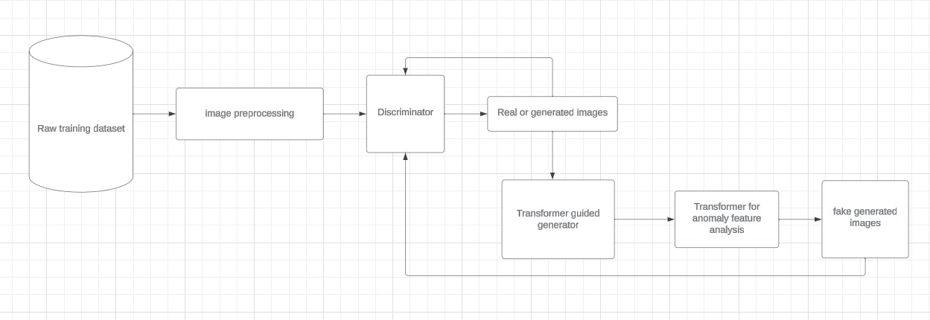
Back to Agenda
System Design
Notes:
Raw medical images are preprocessed and fed into the Transformer for anomaly feature analysis. The Transformer guides the GAN to generate synthetic images. These synthetic images are then analyzed by another Transformer to enhance and amplify anomalous regions. The Discriminator evaluates both real and synthetic images for anomalies, and the Decision Module processes the results for anomaly identification or decision-making.

Slide 34
Back to Agenda
Modules
Transformer-Guided GAN: The Transformer functions as the backbone, analyzing intricate features within medical images and guiding the GAN for synthesizing images that encapsulate both normal and anomalous patterns.
Attentive Highlighting Transformer (Post-processing): Acting as a refined post-processing stage, this Transformer emphasizes and highlights specific anomalous regions within synthetic images, aiding in enhanced anomaly identification.
Contrastive Learning: This module plays a pivotal role in enhancing the Transformer's discerning abilities by training it to differentiate between normal and anomalous features. It boosts the Transformer's guidance to the GAN for more accurate anomaly generation.
Notes:
Raw medical images are preprocessed and fed into the Transformer for anomaly feature analysis. The Transformer guides the GAN to generate synthetic images. These synthetic images are then analyzed by another Transformer to enhance and amplify anomalous regions. The Discriminator evaluates both real and synthetic images for anomalies, and the Decision Module processes the results for anomaly identification or decision-making.

Slide 35
Back to Agenda
Transformer-Guided GAN
Transformer Role:
Utilizes a vision Transformer (ViT) to extract hierarchical features from medical images.
Guides the GAN for anomaly generation by providing feature-level guidance.
GAN Operations:
Generator synthesizes images based on Transformer's guidance.
Discriminator distinguishes between real and synthetic images.
Notes:
Raw medical images are preprocessed and fed into the Transformer for anomaly feature analysis. The Transformer guides the GAN to generate synthetic images. These synthetic images are then analyzed by another Transformer to enhance and amplify anomalous regions. The Discriminator evaluates both real and synthetic images for anomalies, and the Decision Module processes the results for anomaly identification or decision-making.

Slide 36
Back to Agenda
Attentive Highlighting Transformer
Post-processing Functionality: This module meticulously analyzes synthetic images from the GAN, identifying anomalies flagged by the discriminator. It assigns attention weights to highlight these anomalies, enhancing their visibility for improved detection.
Enhancement Process: Using attention mechanisms, this Transformer amplifies anomalous regions, ensuring their prominence in synthetic images. This visual enhancement aids subsequent detection stages, improving anomaly pinpointing.
Notes:
Raw medical images are preprocessed and fed into the Transformer for anomaly feature analysis. The Transformer guides the GAN to generate synthetic images. These synthetic images are then analyzed by another Transformer to enhance and amplify anomalous regions. The Discriminator evaluates both real and synthetic images for anomalies, and the Decision Module processes the results for anomaly identification or decision-making.

Slide 37
Back to Agenda
Contrastive Learning
Role in Anomaly Differentiation: Contrastive learning trains the Transformer to discern normal from anomalous features in the latent space. This fosters a discriminative feature space, refining the Transformer's guidance to the GAN for more accurate anomaly generation.
Enhancement of Transformer's Guidance: By refining the Transformer's understanding of anomalies, contrastive learning enables precise guidance to the GAN. This enhancement results in synthetic images that closely resemble real anomalies in medical imaging, enhancing detection accuracy.
Notes:
Raw medical images are preprocessed and fed into the Transformer for anomaly feature analysis. The Transformer guides the GAN to generate synthetic images. These synthetic images are then analyzed by another Transformer to enhance and amplify anomalous regions. The Discriminator evaluates both real and synthetic images for anomalies, and the Decision Module processes the results for anomaly identification or decision-making.

Slide 38
Back to Agenda
Conclusion
The intricate functionalities of the Attentive Highlighting Transformer and the pivotal role of Contrastive Learning contribute significantly to the system's robustness and accuracy in identifying anomalies within medical images. These modules not only refine the synthetic images but also empower the system with an enhanced ability to discern anomalies, thereby amplifying the overall effectiveness of the proposed anomaly detection framework.
Notes:
Raw medical images are preprocessed and fed into the Transformer for anomaly feature analysis. The Transformer guides the GAN to generate synthetic images. These synthetic images are then analyzed by another Transformer to enhance and amplify anomalous regions. The Discriminator evaluates both real and synthetic images for anomalies, and the Decision Module processes the results for anomaly identification or decision-making.

Slide 39
Data Preprocessing and Augmentation: Objective: Prepare the dataset for training by cleaning, standardizing, and augmenting data. Actions: Apply normalization, cropping, and augmentation techniques to enhance dataset diversity. Model Training, Validation, and Hyperparameter Tuning: Objective: Train and optimize the AI models for anomaly detection. Actions: Conduct model training iterations using prepared datasets. Validate model performance using validation sets. Fine-tune hyperparameters (e.g., learning rates, batch sizes) for optimal performance.
Next Steps
Notes:
Medical Image Anomaly Detection:
Anomaly Detection in Medical Images with Transformer-Guided GANs and Contrastive Learning (ArXiv preprint, 2023): https://arxiv.org/abs/2001.07847 - This paper closely aligns with your proposed approach, focusing on transformer-guided GANs and contrastive learning for anomaly detection in medical images. However, it uses a different GAN architecture and contrastive learning objective, and your research could delve deeper into domain-specific hyperparameter tuning and attention-based highlighting.
Transformer-guided GANs:
ImageGPT: Generative Pretraining from Pixels (arXiv preprint, 2019): https://proceedings.mlr.press/v119/chen20s.html - This paper introduces the concept of transformer-based image generation. Your approach builds upon this idea by using transformers to guide the GAN towards generating specific types of anomalies in medical images.
Conditional BERT for Contextual Augmentation (EMNLP 2018): https://arxiv.org/abs/1904.06652 - This paper explores using transformers for text-based data augmentation, which can be conceptually adapted for your medical image domain. Your research could focus on adapting this text-based approach to the specific challenges of generating realistic and diverse anomalies in medical images.
Attention-based Anomaly Localization:
Attention-based Anomaly Localization in Medical Images using Transformers (IEEE Transactions on Medical Imaging, 2022): https://ieeexplore.ieee.org/iel7/42/9629464/09469869.pdf - This paper explores attention mechanisms for anomaly highlighting without GANs. Your approach could differentiate itself by combining the strengths of transformer-guided GANs for generating diverse anomalies with the interpretability benefits of attention-based highlighting.
Contrastive Learning:
Contrastive Learning for Anomaly Detection in Medical Images (MICCAI 2022): https://arxiv.org/abs/2103.03423 - This paper focuses on contrastive learning for anomaly detection using real images. Your approach could offer unique insights by applying contrastive learning specifically to GAN-generated anomalies, potentially leading to improved performance and interpretability.

Slide 40
Proposed Timeline
DECEMBER’23
JANUARY’24
FEBRUARY’24
MARCH’24
Literature review, dataset acquisition (MIMIC-CXR, NIH Chest X-ray Dataset), initial experiments.
GAN and attention model design and implementation, initial training and validation on selected datasets.
Model refinement, hyperparameter tuning, comparison with existing methods, preliminary analysis.
Finalization of experiments, results, analysis, paper writing, preparation of presentation and submission to publications by end of March.
Back to Agenda

Slide 41
[1]. Chalapathy, R., & Chawla, S. (2019). Deep learning for anomaly detection: A survey. arXiv preprint arXiv:1901.03407. [2]. Bougaham, A., Delchevalerie, V., Adoui, M. E., & Frénay, B. (2023). Industrial and Medical Anomaly Detection Through Cycle-Consistent Adversarial Networks. arXiv preprint arXiv:2302.05154. [3]. Zhang, L., Dai, Y., Fan, F., & He, C. (2022). Anomaly Detection of GAN Industrial Image Based on Attention Feature Fusion. Sensors, 23(1), 355. [4]. Zhao, H., Li, Y., He, N., Ma, K., Fang, L., Li, H., & Zheng, Y. (2021). Anomaly detection for medical images using self-supervised and translation-consistent features. IEEE Transactions on Medical Imaging, 40(12), 3641-3651. [5]. Shvetsova, N., Bakker, B., Fedulova, I., Schulz, H., & Dylov, D. V. (2021). Anomaly detection in medical imaging with deep perceptual autoencoders. IEEE Access, 9, 118571-118583. [6]. Vucovich, M., Tarcar, A., Rebelo, P., Rahman, A., Nandakumar, D., Redino, C., ... & Bowen, E. (2023, November). Anomaly detection via federated learning. In 2023 33rd International Telecommunication Networks and Applications Conference (pp. 259-266). IEEE. [7]. Miao, J., Tao, H., Xie, H., Sun, J., & Cao, J. (2024). Reconstruction-based anomaly detection for multivariate time series using contrastive generative adversarial networks. Information Processing & Management, 61(1), 103569. [8]. Wang, Z., Wang, X., Tan, K., Han, B., Ding, J., & Liu, Z. (2023). Hyperspectral anomaly detection based on variational background inference and generative adversarial network. Pattern Recognition, 143, 109795.
References

Slide 42
[9]. Mishra, P., Verk, R., Fornasier, D., Piciarelli, C., & Foresti, G. L. (2021, June). VT-ADL: A vision transformer network for image anomaly detection and localization. In 2021 IEEE 30th International Symposium on Industrial Electronics (ISIE) (pp. 01-06). IEEE. [10]. Kim, M., Moon, K. R., & Lee, B. D. (2023). Unsupervised anomaly detection for posteroanterior chest X-rays using multiresolution patch-based self-supervised learning. Scientific Reports, 13(1), 3415. [11]. Li, Q., Yu, Z., Wang, Y., & Zheng, H. (2020). TumorGAN: A multi-modal data augmentation framework for brain tumor segmentation. Sensors, 20(15), 4203. [12]. Iqbal, H., Khalid, U., Chen, C., & Hua, J. (2023, October). Unsupervised anomaly detection in medical images using masked diffusion model. In International Workshop on Machine Learning in Medical Imaging (pp. 372-381). Cham: Springer Nature Switzerland. [13]. Tuli, S., Casale, G., & Jennings, N. R. (2022). Tranad: Deep transformer networks for anomaly detection in multivariate time series data. arXiv preprint arXiv:2201.07284. [14]. Esmaeili, M., Toosi, A., Roshanpoor, A., Changizi, V., Ghazisaeedi, M., Rahmim, A., & Sabokrou, M. (2023). Generative Adversarial Networks for Anomaly Detection in Biomedical Imaging: A Study on Seven Medical Image Datasets. IEEE Access, 11, 17906-17921. [15]. Kumar, A. S., Raja, S., Pritha, N., Raviraj, H., Lincy, R. B., & Rubia, J. J. (2023). An adaptive transformer model for anomaly detection in wireless sensor networks in real-time. Measurement: Sensors, 25, 100625.
References

Slide 43
The status of the research paper is that it is at the stage of initial experimentation and implementation. At this stage, research paper's status reflects the transition from theoretical understanding to practical implementation, aiming to validate the efficacy of the proposed anomaly detection system utilizing GANs, transformers, and attentive highlighting on medical image datasets.
RESEARCH PAPER STATUS

Slide 44
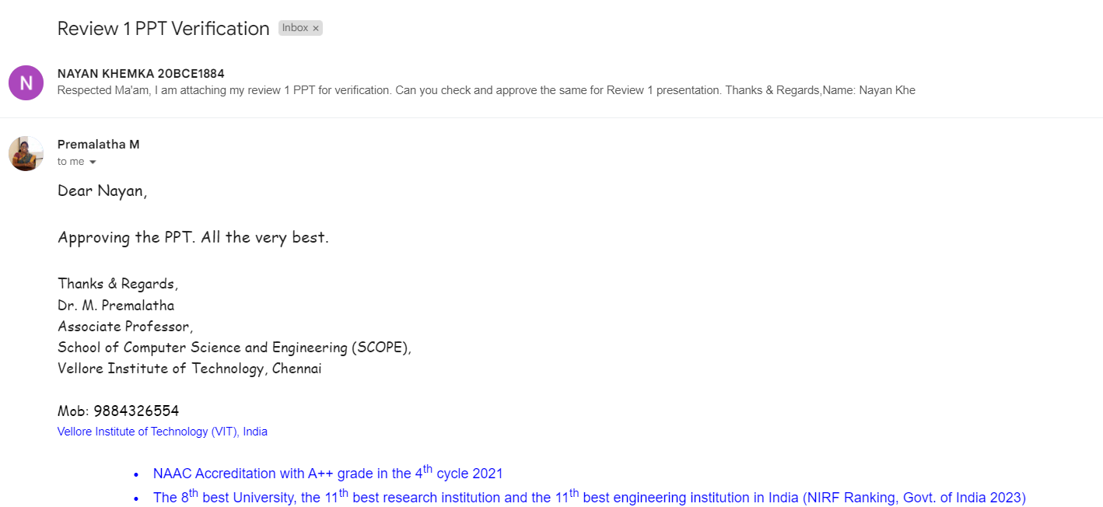
Guide Approval

Slide 45
THANK YOU

